Slide 1
Reactive programming

Slide 2
Presentation
What are reactive apps?
Motivation
Solution
Problems that we encountered
End advices

Slide 3
What is a reactive app?
A reactive app is an app that is build as a stream of components that react to new data
In computing, reactive programming is an asynchronous programming paradigm concerned with data streams and the propagation of change. This means that it becomes possible to express static (e.g. arrays) or dynamic (e.g. event emitters) data streams with ease via the employed programming language(s), and that an inferred dependency within the associated execution model exists, which facilitates the automatic propagation of the change involved with data flow.

Slide 4
Presentation
What are reactive apps?
Motivation
Solution
Problems that we encountered
End advices

Slide 5
What problem do we want to solve?
Have complex apps
Easy to modify
Easy to understand
Easy to test performance

Slide 6
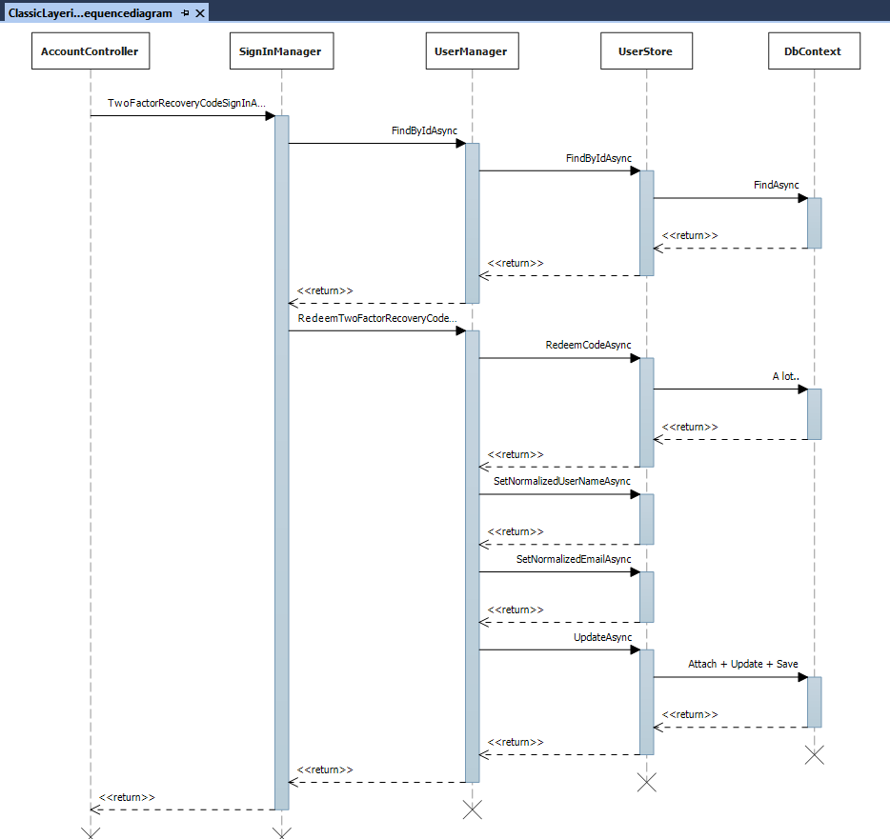

Slide 7
Class length
SignInManager – 800 lines
UserManager – 2500 lines
UserStore – 1500 lines

Slide 8
UserManager Dependencies
IUserStore<TUser> store,
IOptions<IdentityOptions> optionsAccessor,
IPasswordHasher<TUser> passwordHasher,
IEnumerable<IUserValidator<TUser>> userValidators,
IEnumerable<IPasswordValidator<TUser>> passwordValidators,
ILookupNormalizer keyNormalizer,
IdentityErrorDescriber errors,
IServiceProvider services,
ILogger<UserManager<TUser>> logger

Slide 9
Testing the application
Unit Tests
Tests on AccountController where you mock SignInManager
Tests on SignInManager where you mock UserManager
Tests on UserManager where you mock UserStore
Tests on UserStore where you mock DbContext
With every mock we assume that the mocked components will work as we expect.
To be a successful mockist, you must dislike mocks.
Where is the bottleneck? – performance tests?

Slide 10
Documentation of the application
Using the code documentation you can see description of some methods
There is no way to automatically generate activity diagrams from the code

Slide 11
Modifying the app
Adding an extra steps, always requiring modifying an existing unit
Breaks Open/closed principle - “software entities … should be open for extension, but closed for modification.”
This breaks the unit’s unit tests, as extra steps are added

Slide 12
Long running flows
How easy it is to write long running flows and track the progress of some requests?

Slide 13
Presentation
What are reactive apps?
Motivation
Solution
Problems that we encountered
End advices

Slide 14
Event-driven architecture (EDA)
Have the application define a clear list of commands and possible transitions between them (Declarative programming)
Have a list of commands/transitions readable through reflection so that we can document them (Declarative programming)
The transitions are done through events
We defined what command should be invoked for what event using attributes
On each command we define what events it may raise
Have commands and events well known by business/QA also
Show in documentation all the possibilities that a worker has through a tree

Slide 15
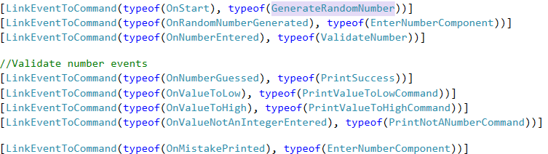
Application bootstrap

Slide 16
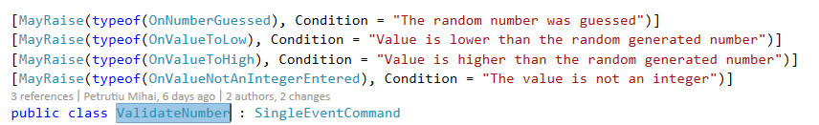

Command/Event declaration

Slide 17
Advantages (Expected)
Ubiquitous language – start talking in the terms of events and commands. (Did not happen)
Components(commands) are decoupled – easy unit testing close to functional specs
Easy to extend – add features by registering new events/commands without modifying existing code.
Logging – easy to add statistics/performance.
Documentation – automatically generated documentation.

Slide 18
Lets see code :D

Slide 19
Presentation
What are reactive apps?
Motivation
Solution
Problems that we encountered
End advices

Slide 20
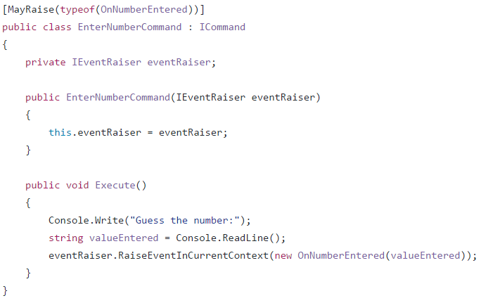
[BAD]Dependency for raising events

Slide 21
Why bad?
We should return a promise/Task/CompletableFuture from the command so that we know the command finished
Hard to unit test, as we need to mock IEventRaiser, and have the assertion on the parameter
Nunit/Junit are not happy with tests that are returning Task/CompletableFuture
Always need to test also that we invoke it X number of times the dependency

Slide 22
[Bad] Return an Iterable/Enumerable list of events
You can see that an enumerable is done, only after you go through all of the records
In case you add new data every X minutes, you will have a thread blocked for that period waiting in a foreach
Also hard to know when the command finished work

Slide 23
[Good] Return Observables
No need for extra dependency
No thread blocked when events are generated only from time to time
Observable collections can be closed, so we know we finished executing
System.Reactive has implementation in a lot of programming languages

Slide 24
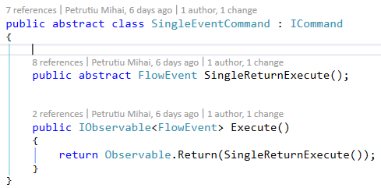
[Good] Make Helper Base commands

Slide 25
[Bad] Link only based on event’s class
You will never be able to use the command twice in the same flow

Slide 26
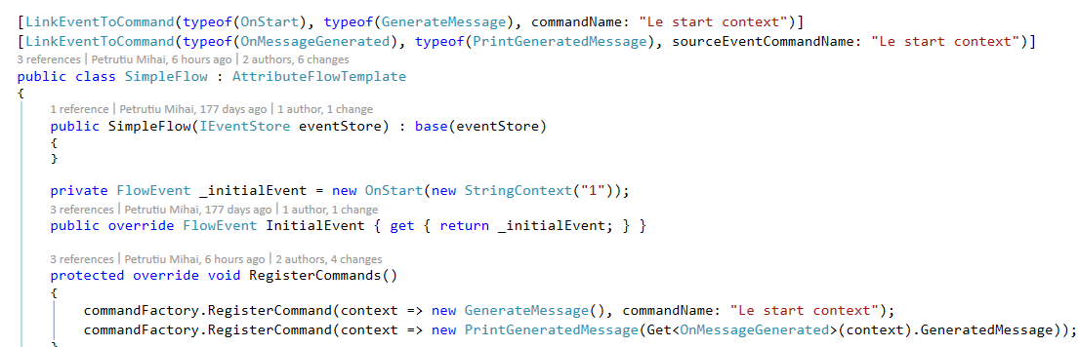
[Good] Have links based on class and name of event

Slide 27
[Bad] Copy paste links from a different flow

Slide 28
[Good] Have aggregate commands

Slide 29
Presentation
What are reactive apps?
Motivation
Solution
Problems that we encountered
End advices

Slide 30
Advices
Define
Define the relationships between commands and events using declarative programming
Prefer
Prefer returning Observables instead of invoking a method that raises events
Don’t inject
Don’t inject events directly into commands
Allow
Allow the registration of commands with specific names
Allow
Allow the creation of aggregate commands for easier reuse
Make
Make Abstract commands for specific situations (SingleEventCommand)

Slide 31
Questions?

